Slide 1

Statistical Analysis on factors influencing Life Expectancy
STAT-632
Linear and Logistic Regression

Slide 2
Problem Statement
To develop a MLR model that can accurately predict life expectancy based on various factors such as economic, social, and health-related indicators, using the World Health Organization (WHO) dataset

Slide 3


DATA
This data set was collected by the Global Health Observatory (GHO) data repository, under WHO, provides health-related data .
Available in Kaggle for public research. Here is the link for the data set.
For this project, data related to life expectancy, health, and economic factors from 2000-2015 were considered.
The variables were categorized into immunization-related factors, mortality factors, economic factors, and social factors

Slide 4
Variables
Year-the year data was gathered
Alcohol- consumption of alcohol, recorded per capita(in liters)
Total expenditure-government expenditure on health as a percentage of total government expenditure (%)
GDP-Gross Domestic Product per capita(USD)
Income composition of resources-Human Development Index(ranging from 0 to 1)

Slide 5
Variables
Schooling-Number of years of Schooling
Population-Country’s Population
Percentage Expenditure-Expenditure on health as a percentage of GDP
HIV AIDS-Deaths per 1 000 live births HIV/AIDS (0-4 years)
Hepatitis B-immunization coverage among 1-year-olds
Measles - number of reported cases per 1000 population

Slide 6
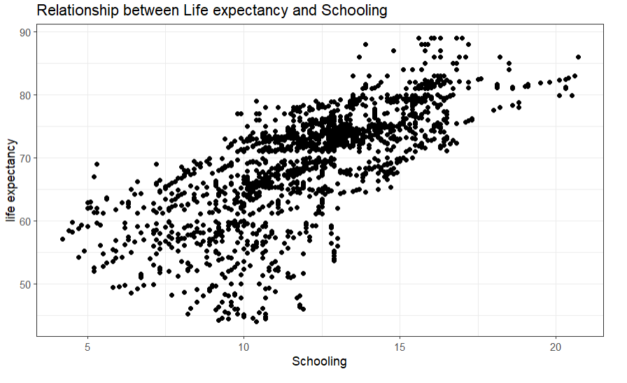
RELATIONSHIP B/W LIFE EXPECTANCY AND SCHOOLING

Slide 7
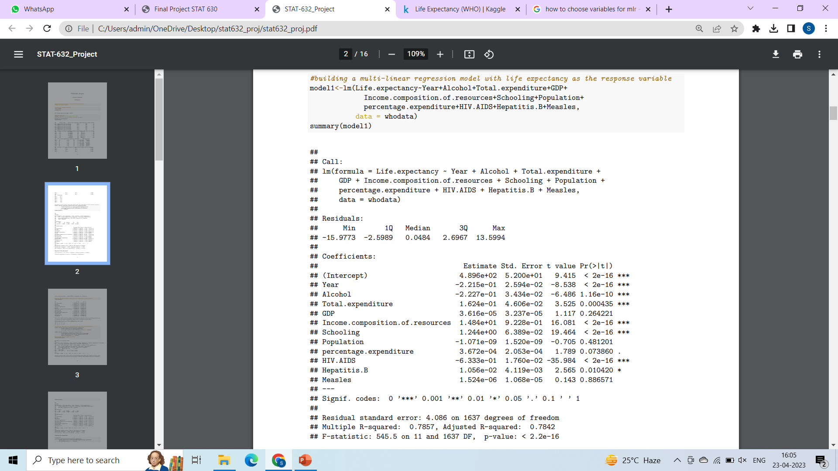
BUILDING THE MODEL
The p-values of GDP , Population and measles >0.05

Slide 8
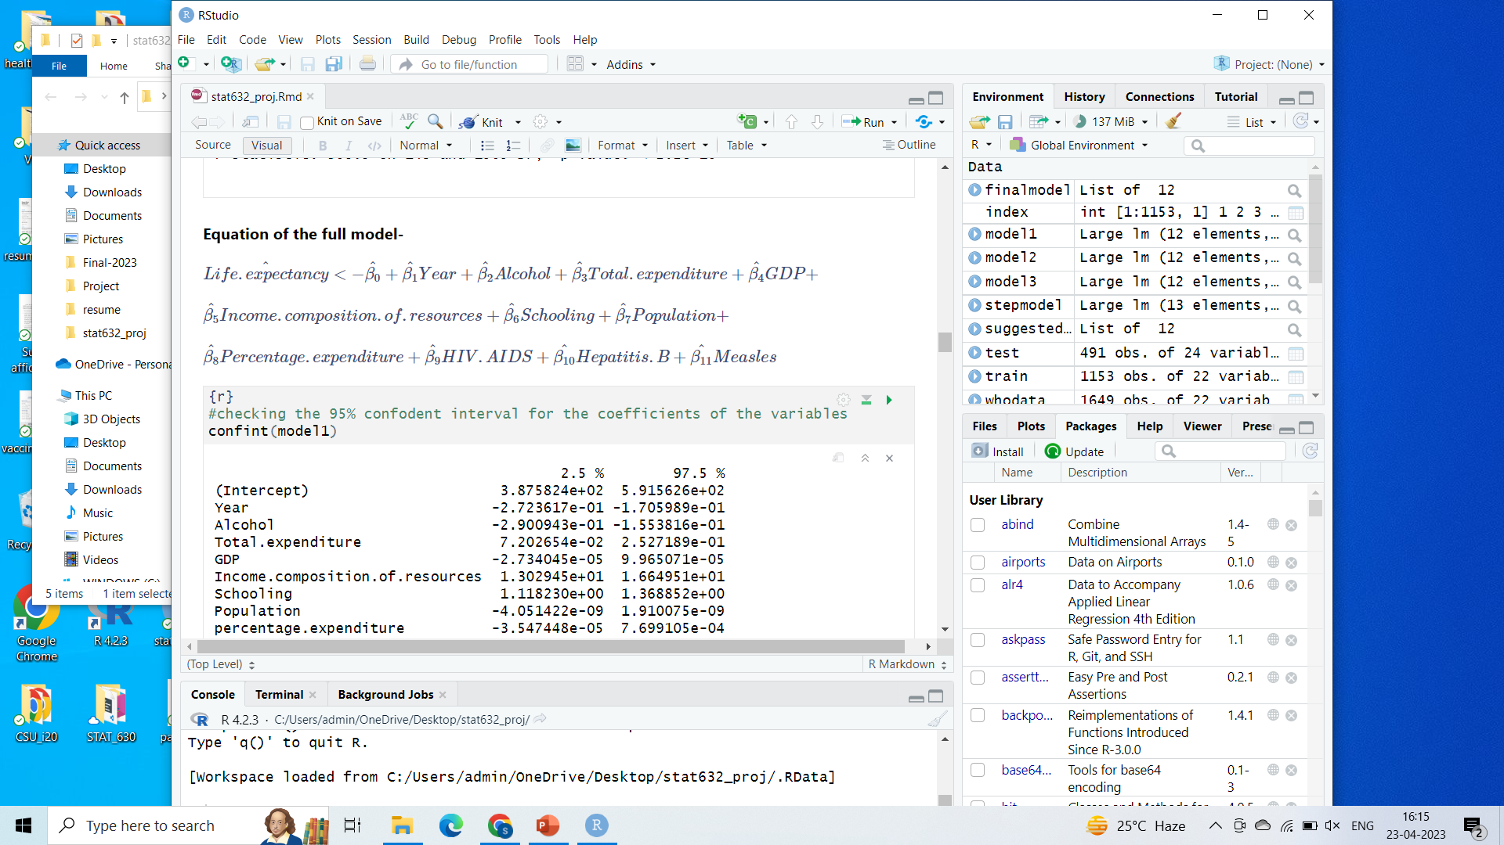
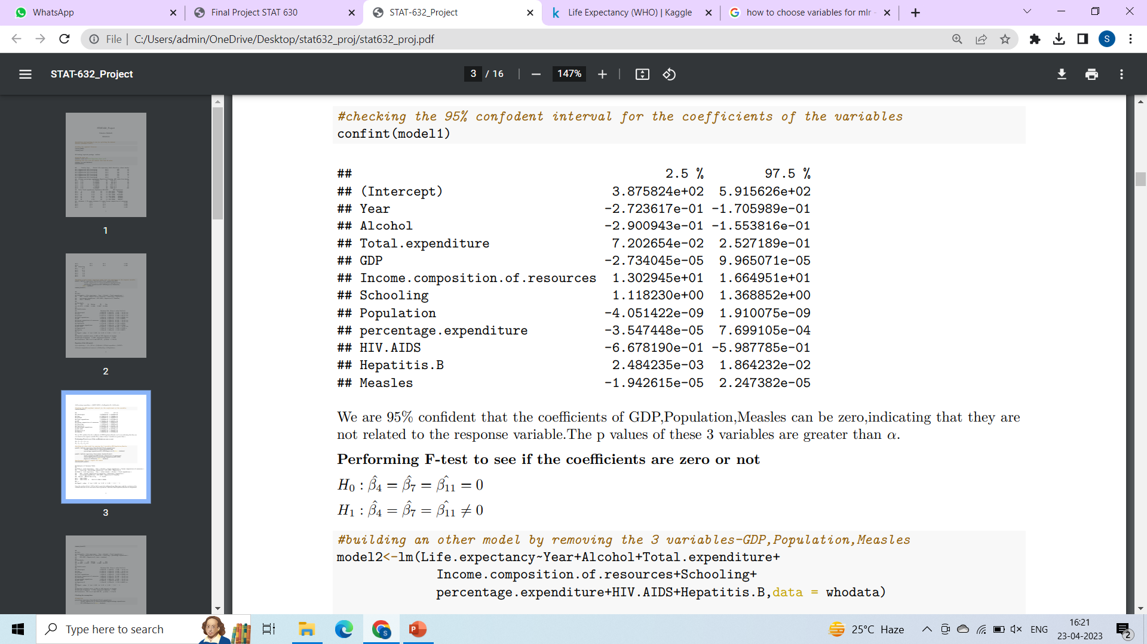
Equation of THE Full model-
CONFIDENCE INTERVALS OF THE PREDICTOR VARIABLES-

Slide 9
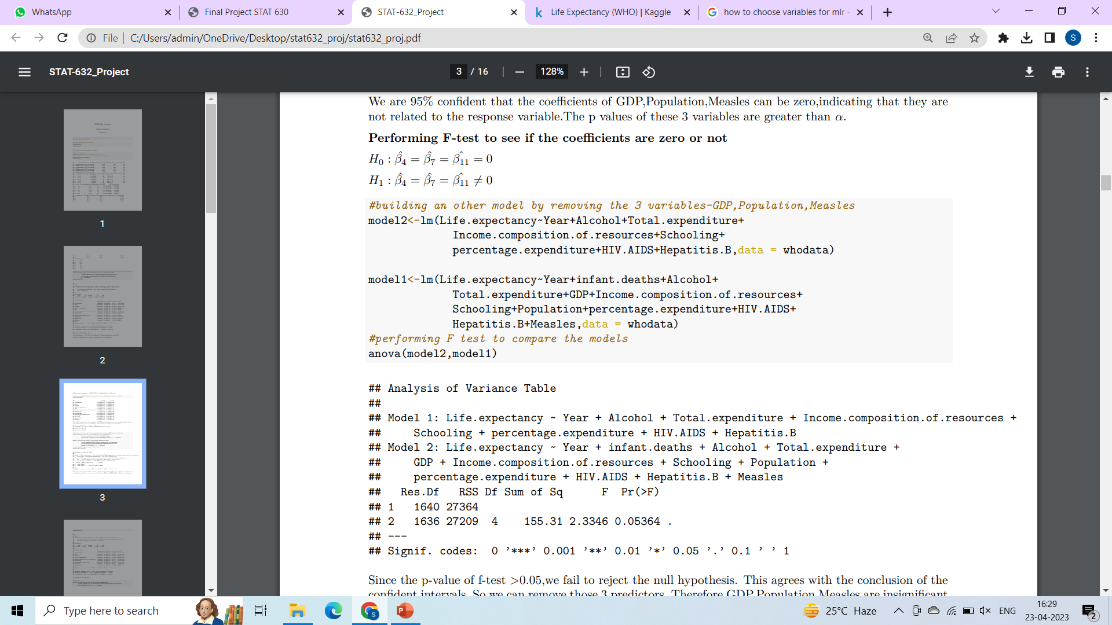
PERFORMING THE Partial F-TEST

Slide 10
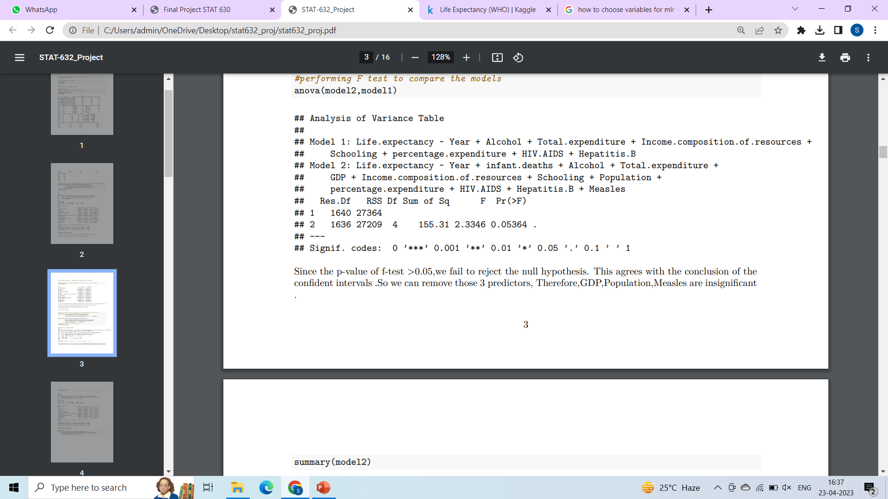
The p-value of the f-test is >0.05,we fail to reject the null hypothesis.
GDP ,Population ,Measles are insignificant

Slide 11
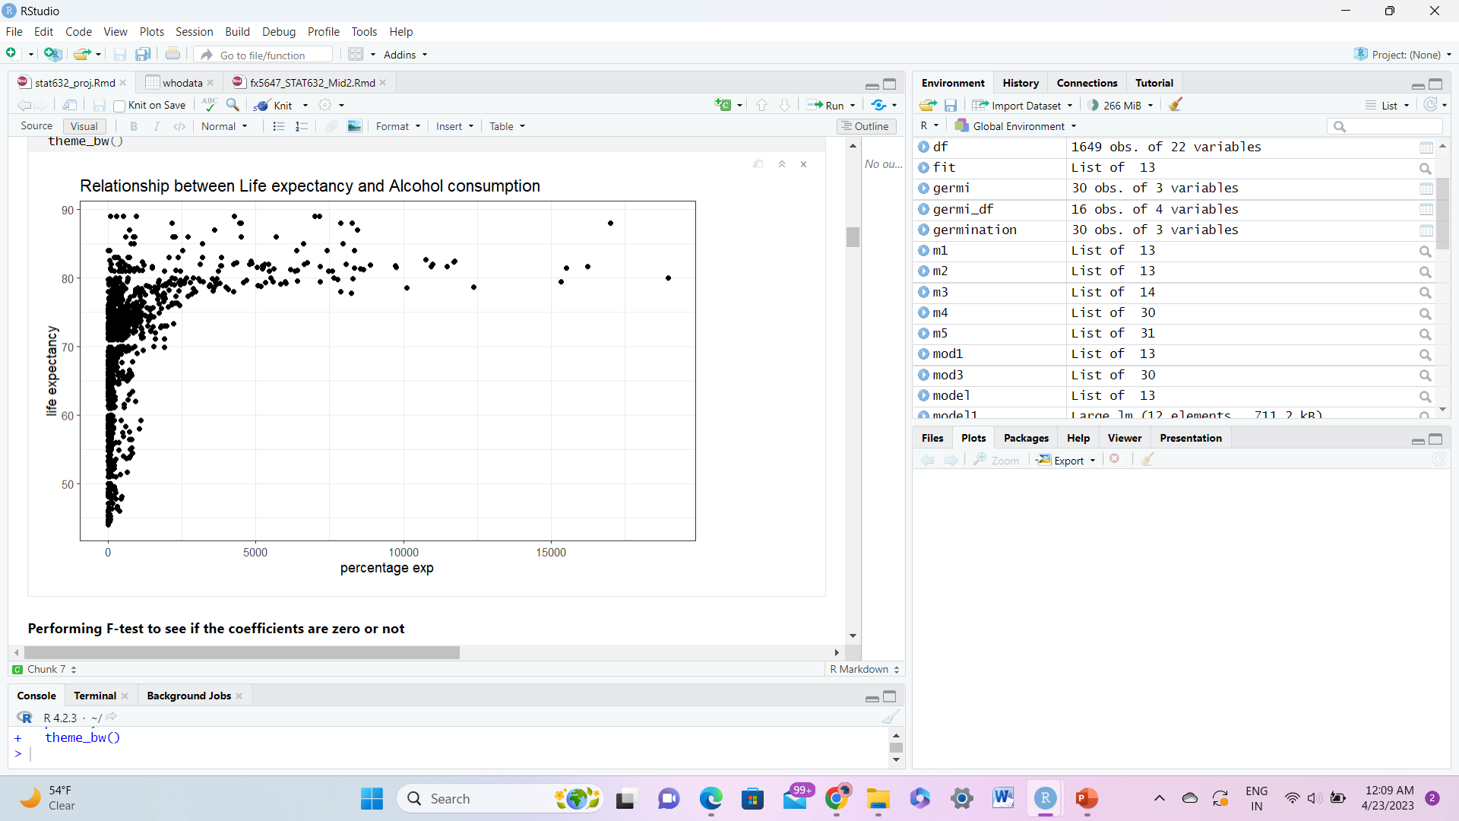
LINEARITY-
The percentage expenditure variable does not have a linear relationship with the response variable . So transformation is required.
CHECKING
ASSUMPTIONS-

Slide 12
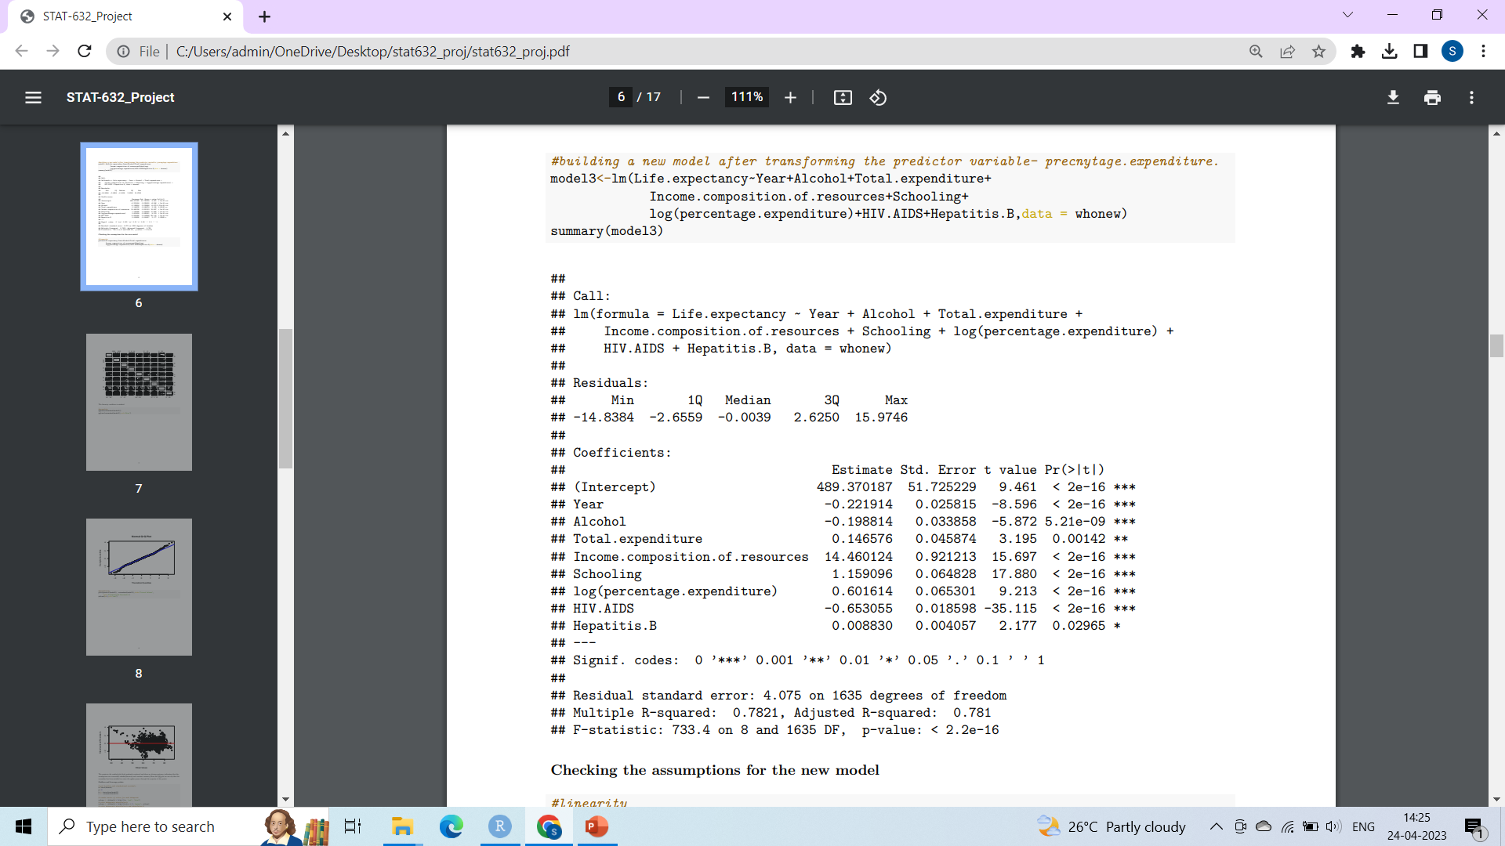
BUILDING THE MODEL(AFTER TRANSFORMATION)

Slide 13
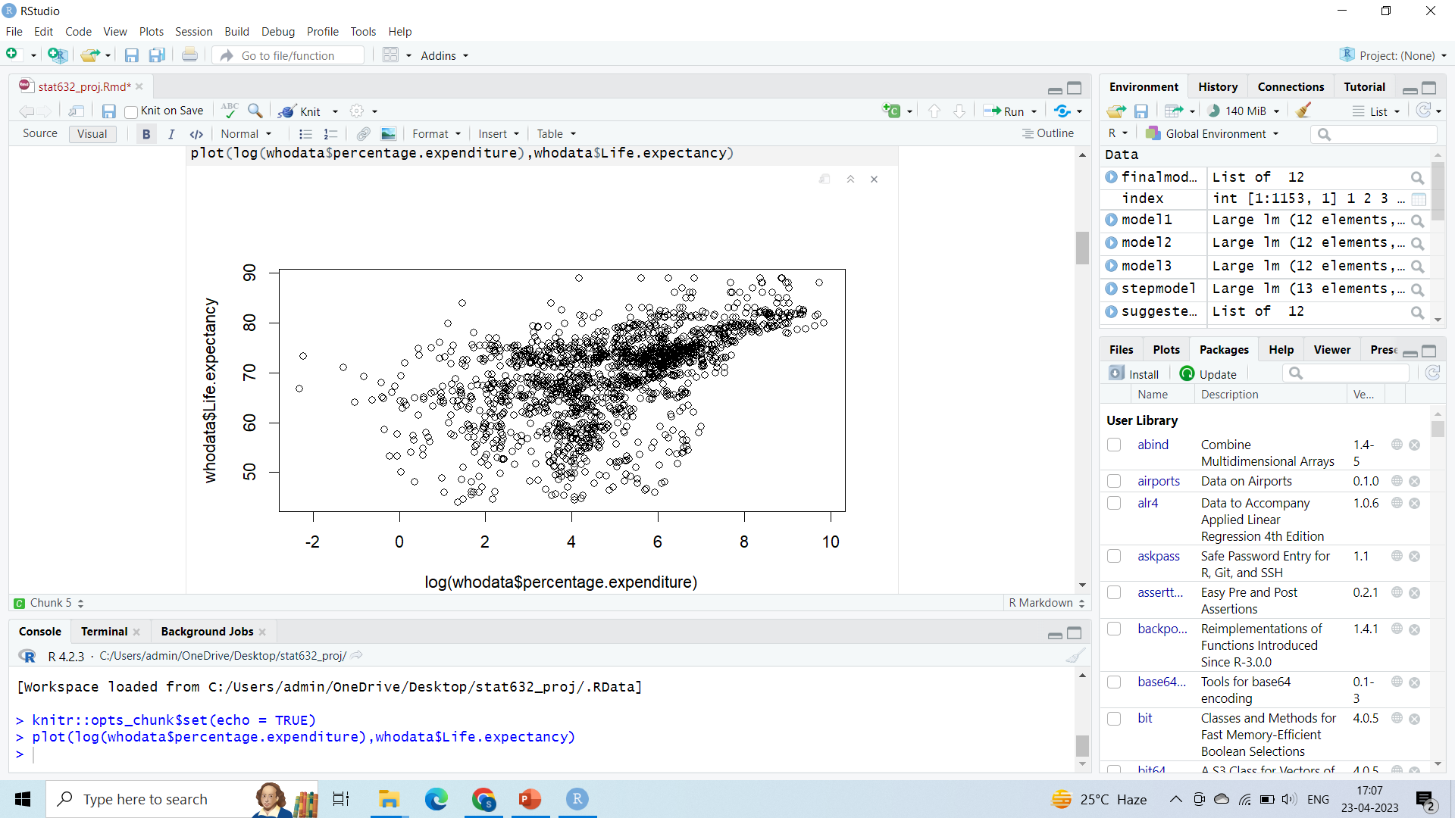
LINEARITY-
CHECKING
ASSUMPTIONS
(AFTER TRANSFORMATION)-

Slide 14
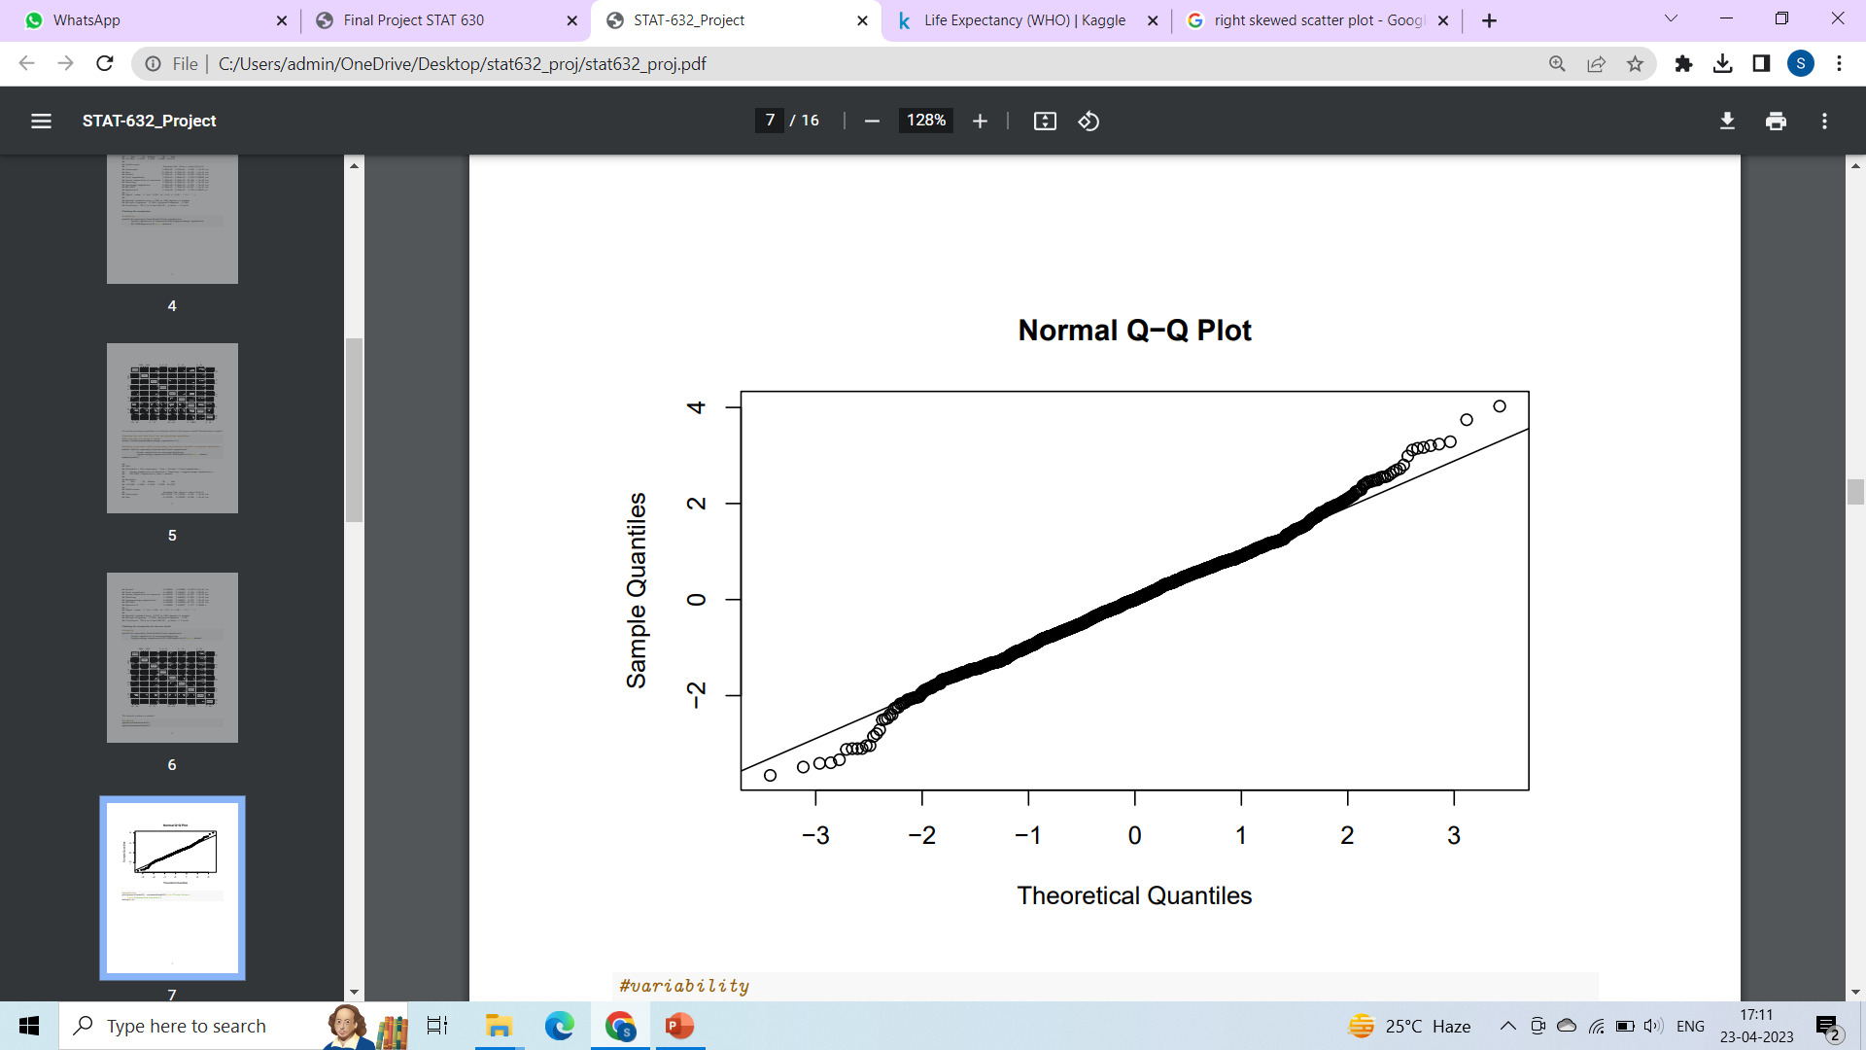
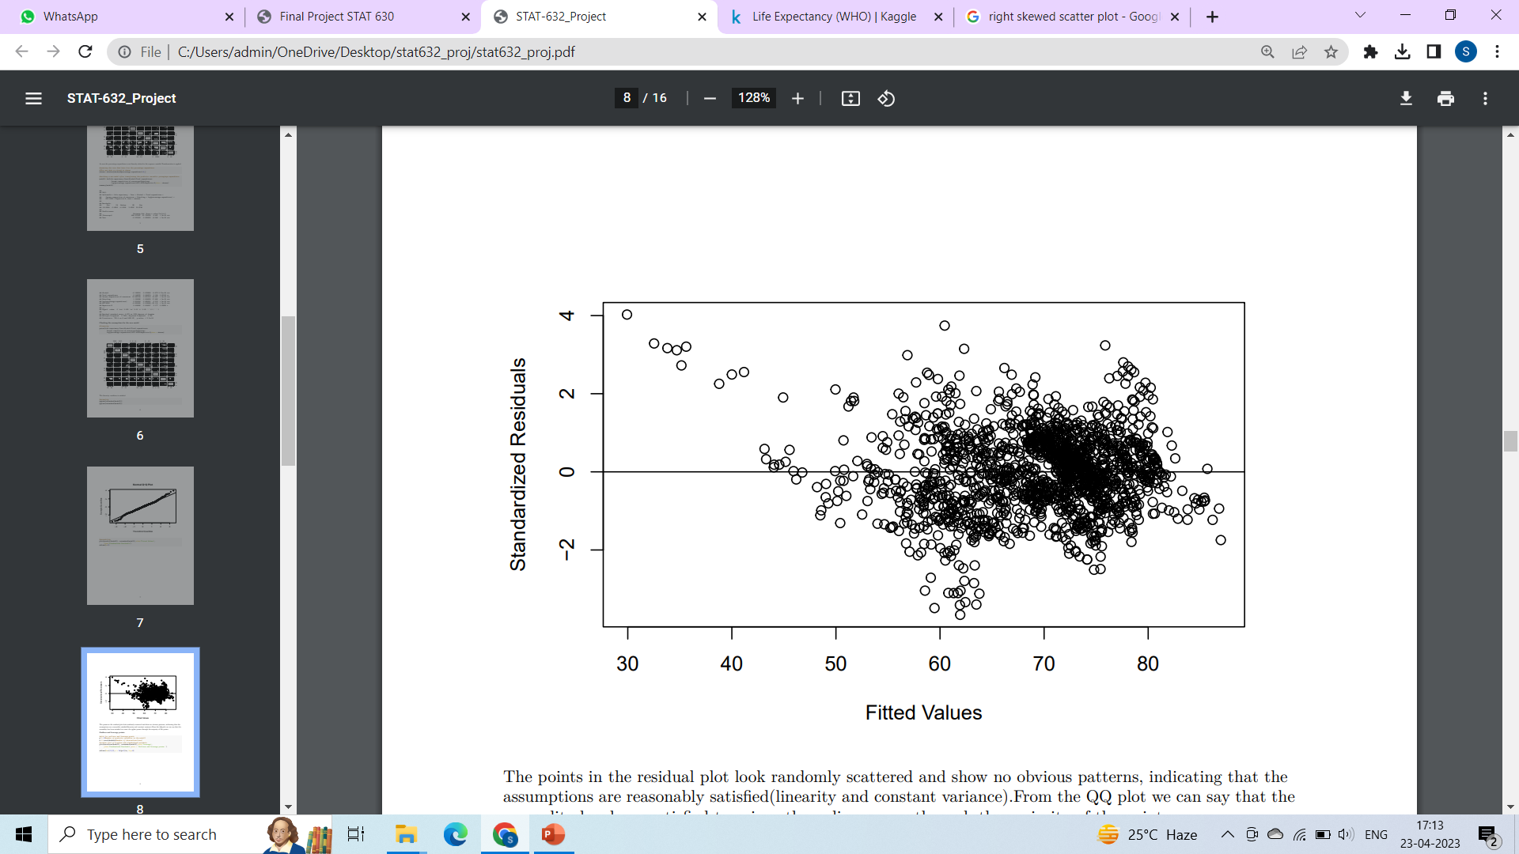
NORMALITY - CHECKING
ASSUMPTIONS
(AFTER
TRANSFORMATION) -
EQUAL VARIANCE-

Slide 15
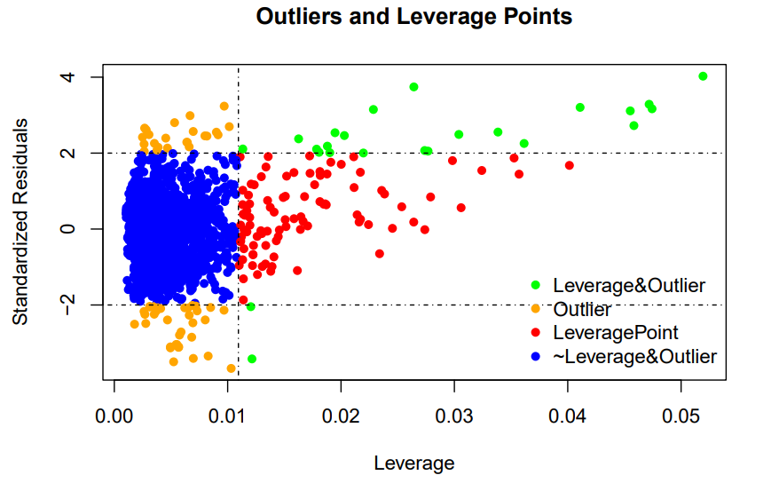
OUTLIERS & LEVERAGE POINTS

Slide 16
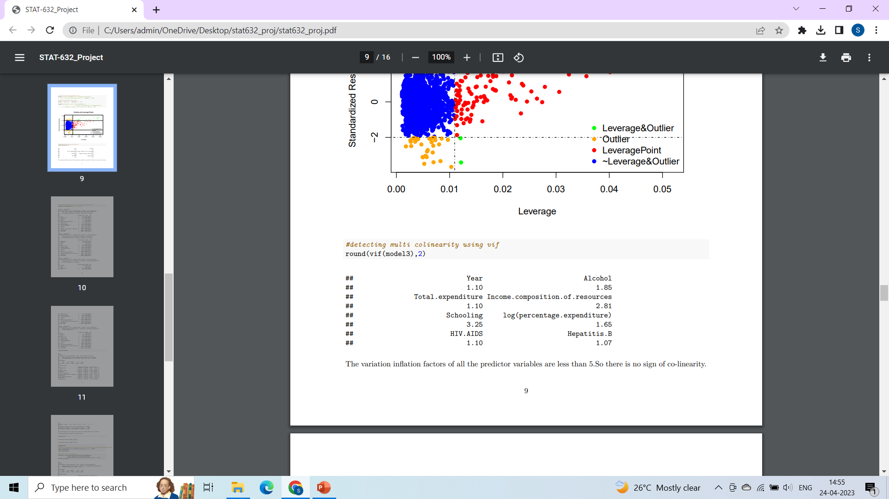
CHECKING FOR COLINEARLITY
The vif values of all the predictor variables is <5

Slide 17
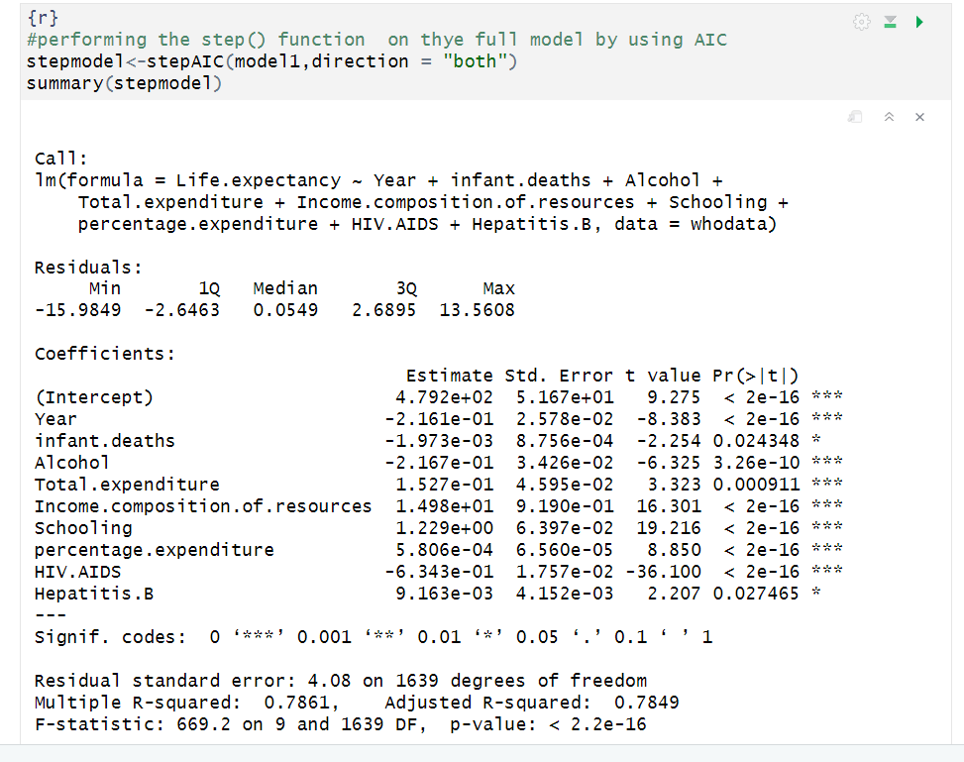
MODEL BY AIC USING step()

Slide 18
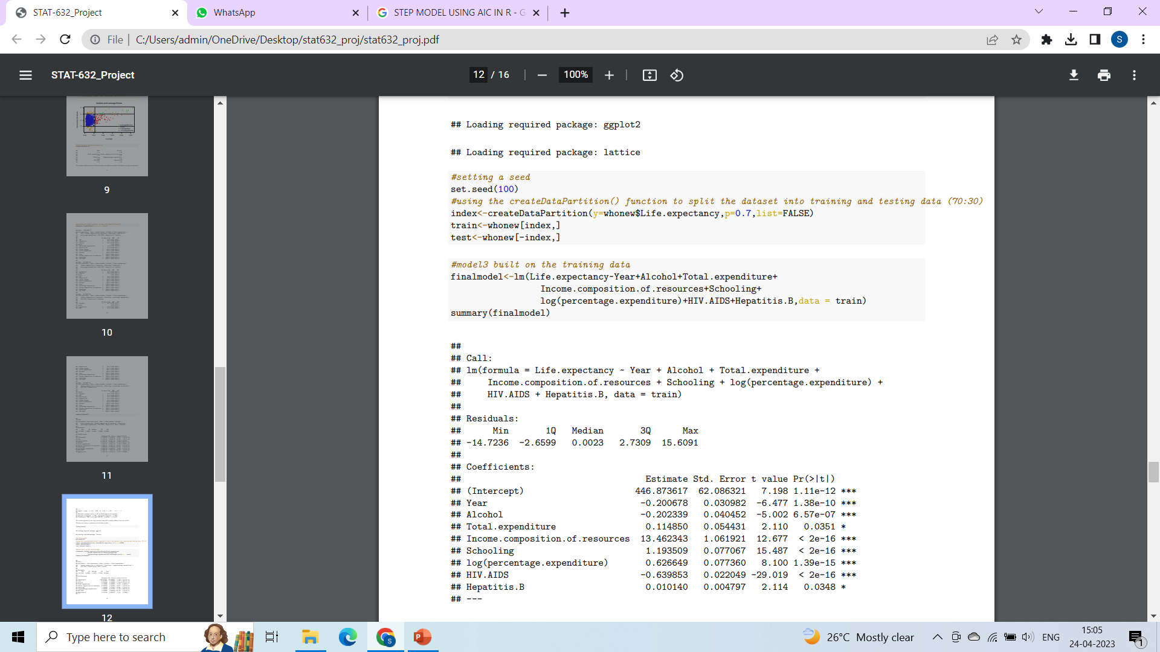
SPLITTING THE DATASET

Slide 19
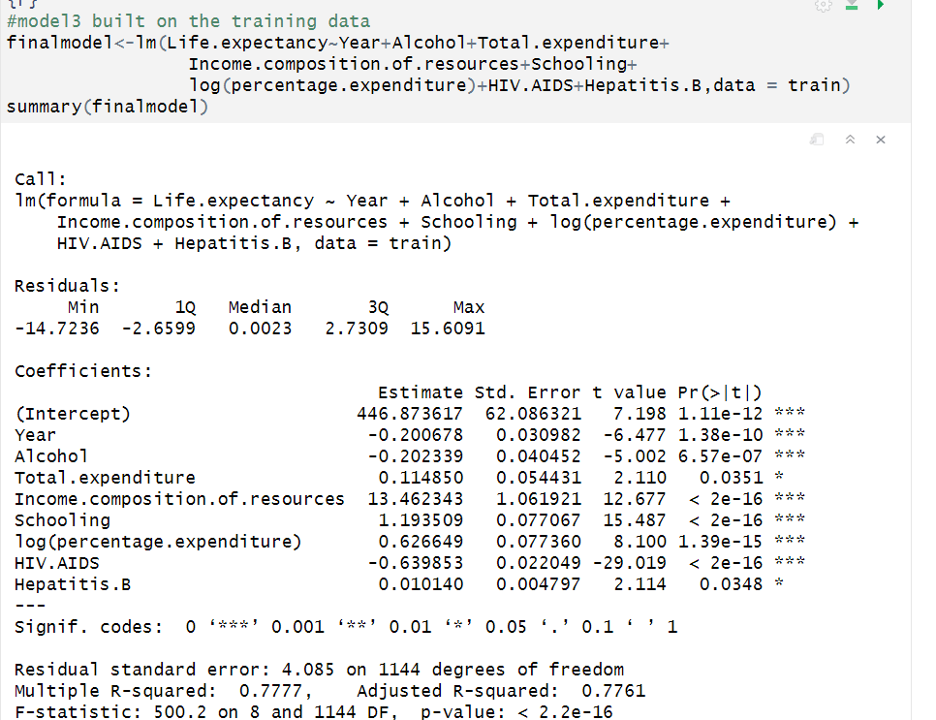
BUILDING THE MLR MODEL (OBTAINED BY REMOVING THE INSIGNIFICANT VARIABLES )ON TRAIN DATA

Slide 20
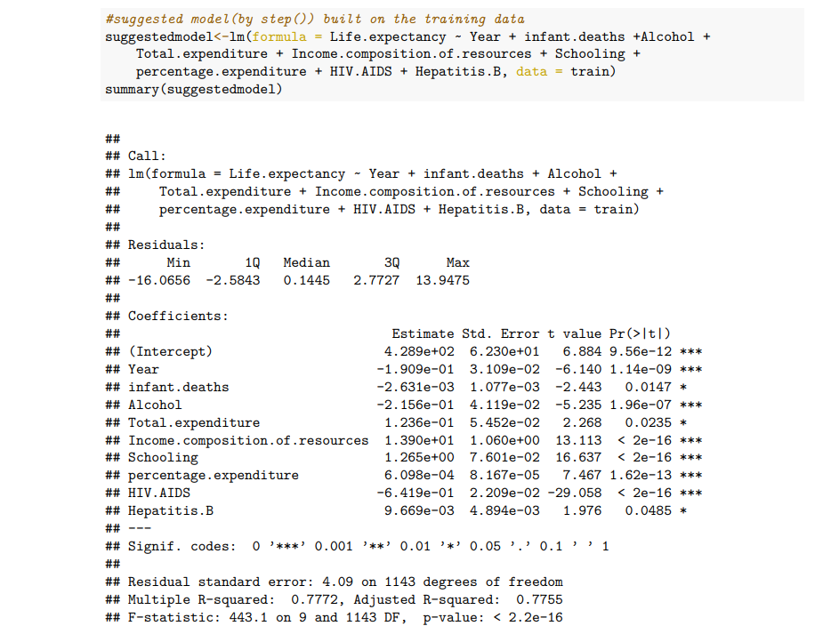
BUILDING THE MLR MODEL (SUGGESTED BY AIC)ON TRAIN DATA

Slide 21
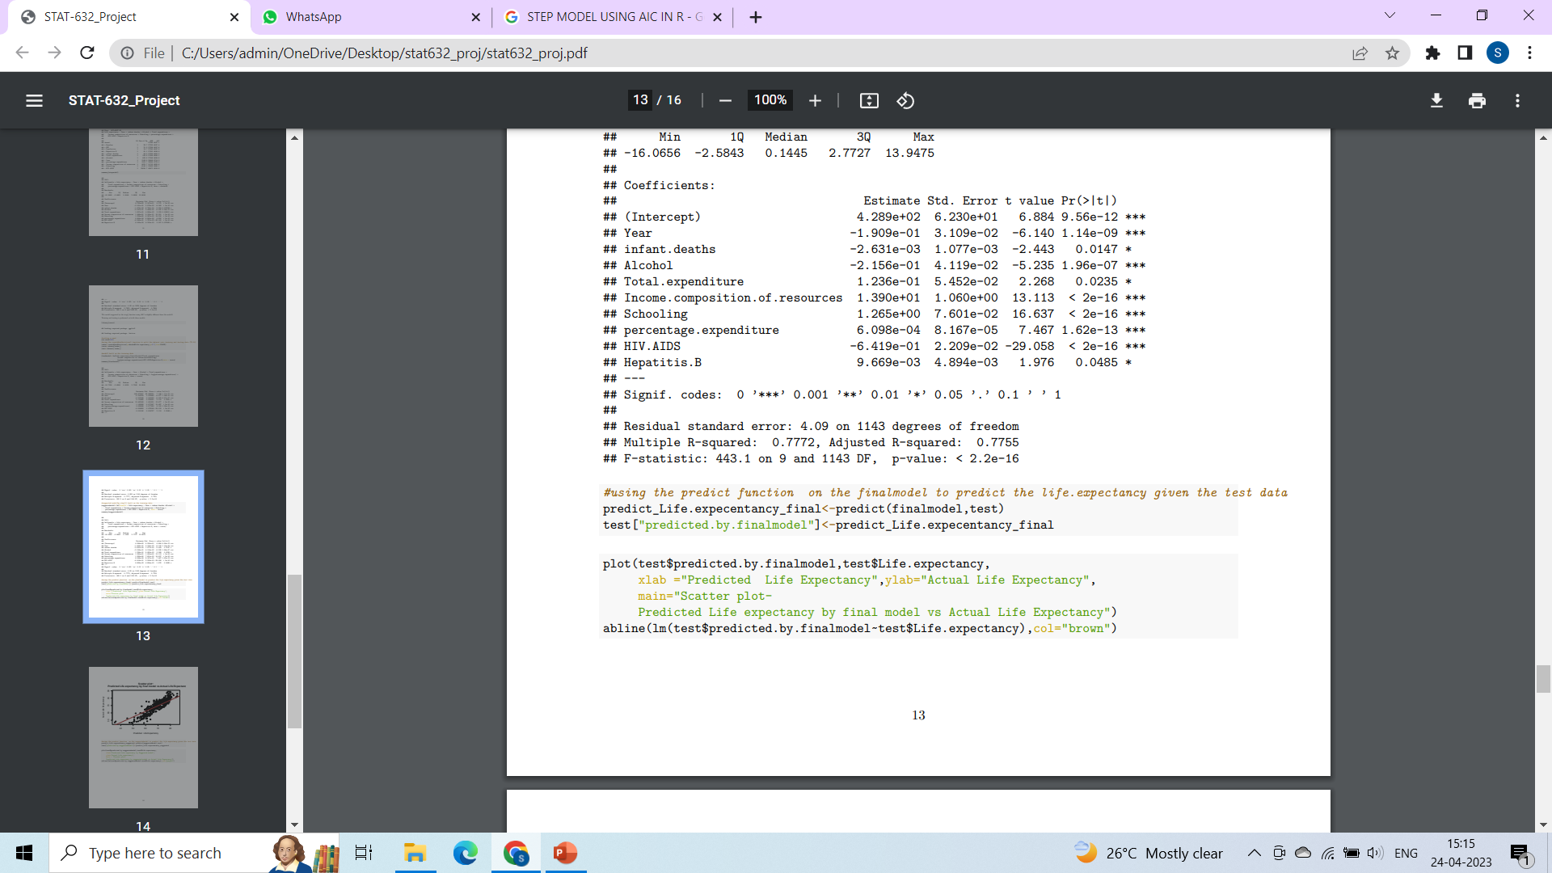
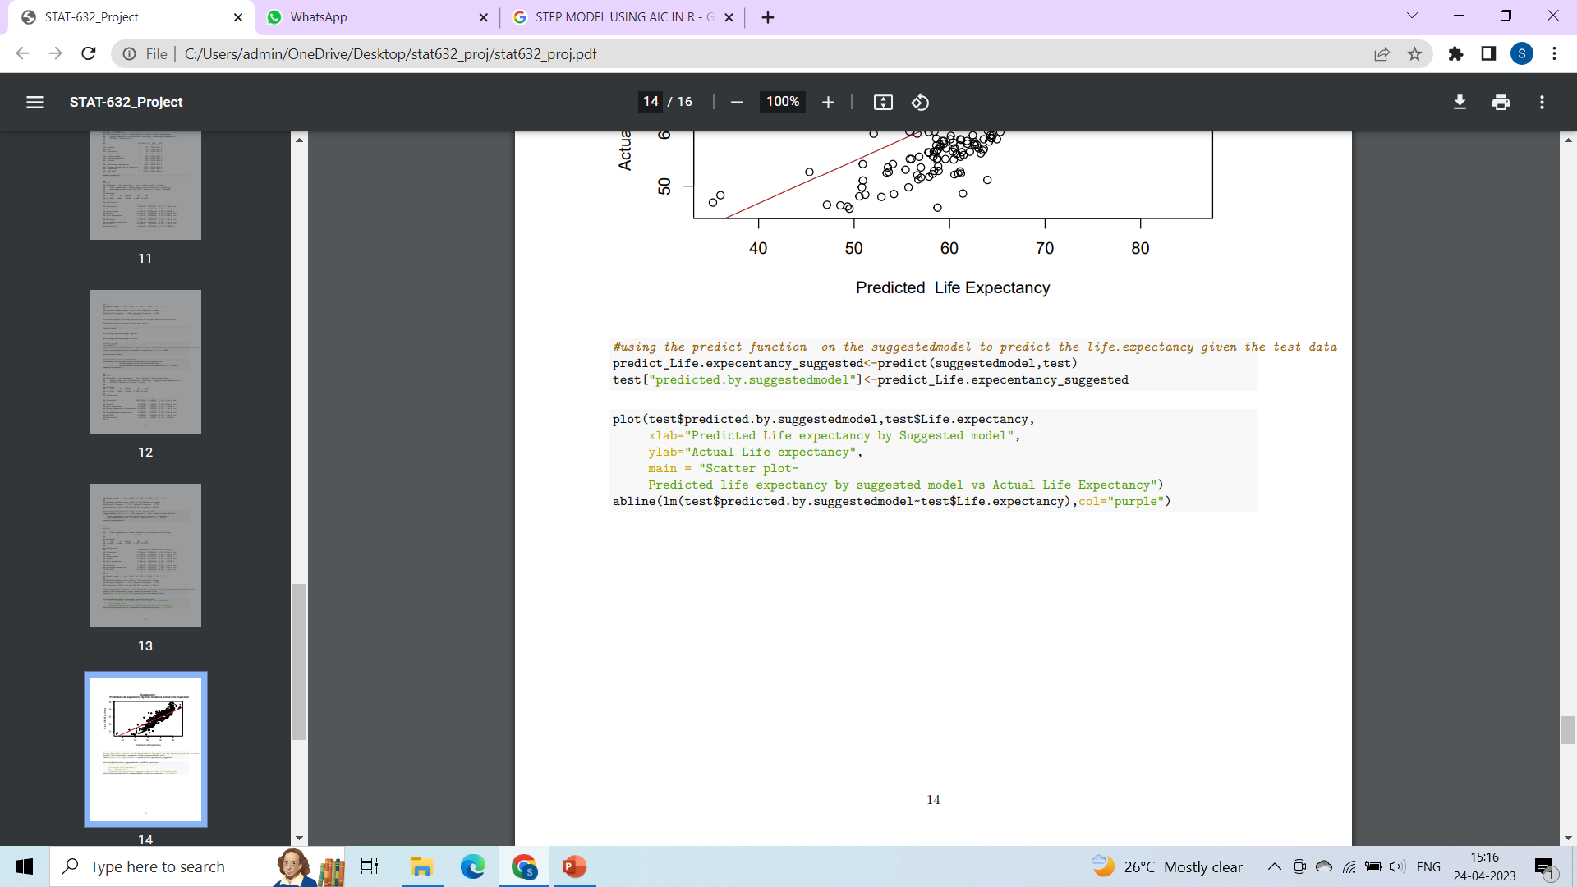
PREDICTING THE LIFE EXPECTANCY USING BOTH THE MODELS

Slide 22
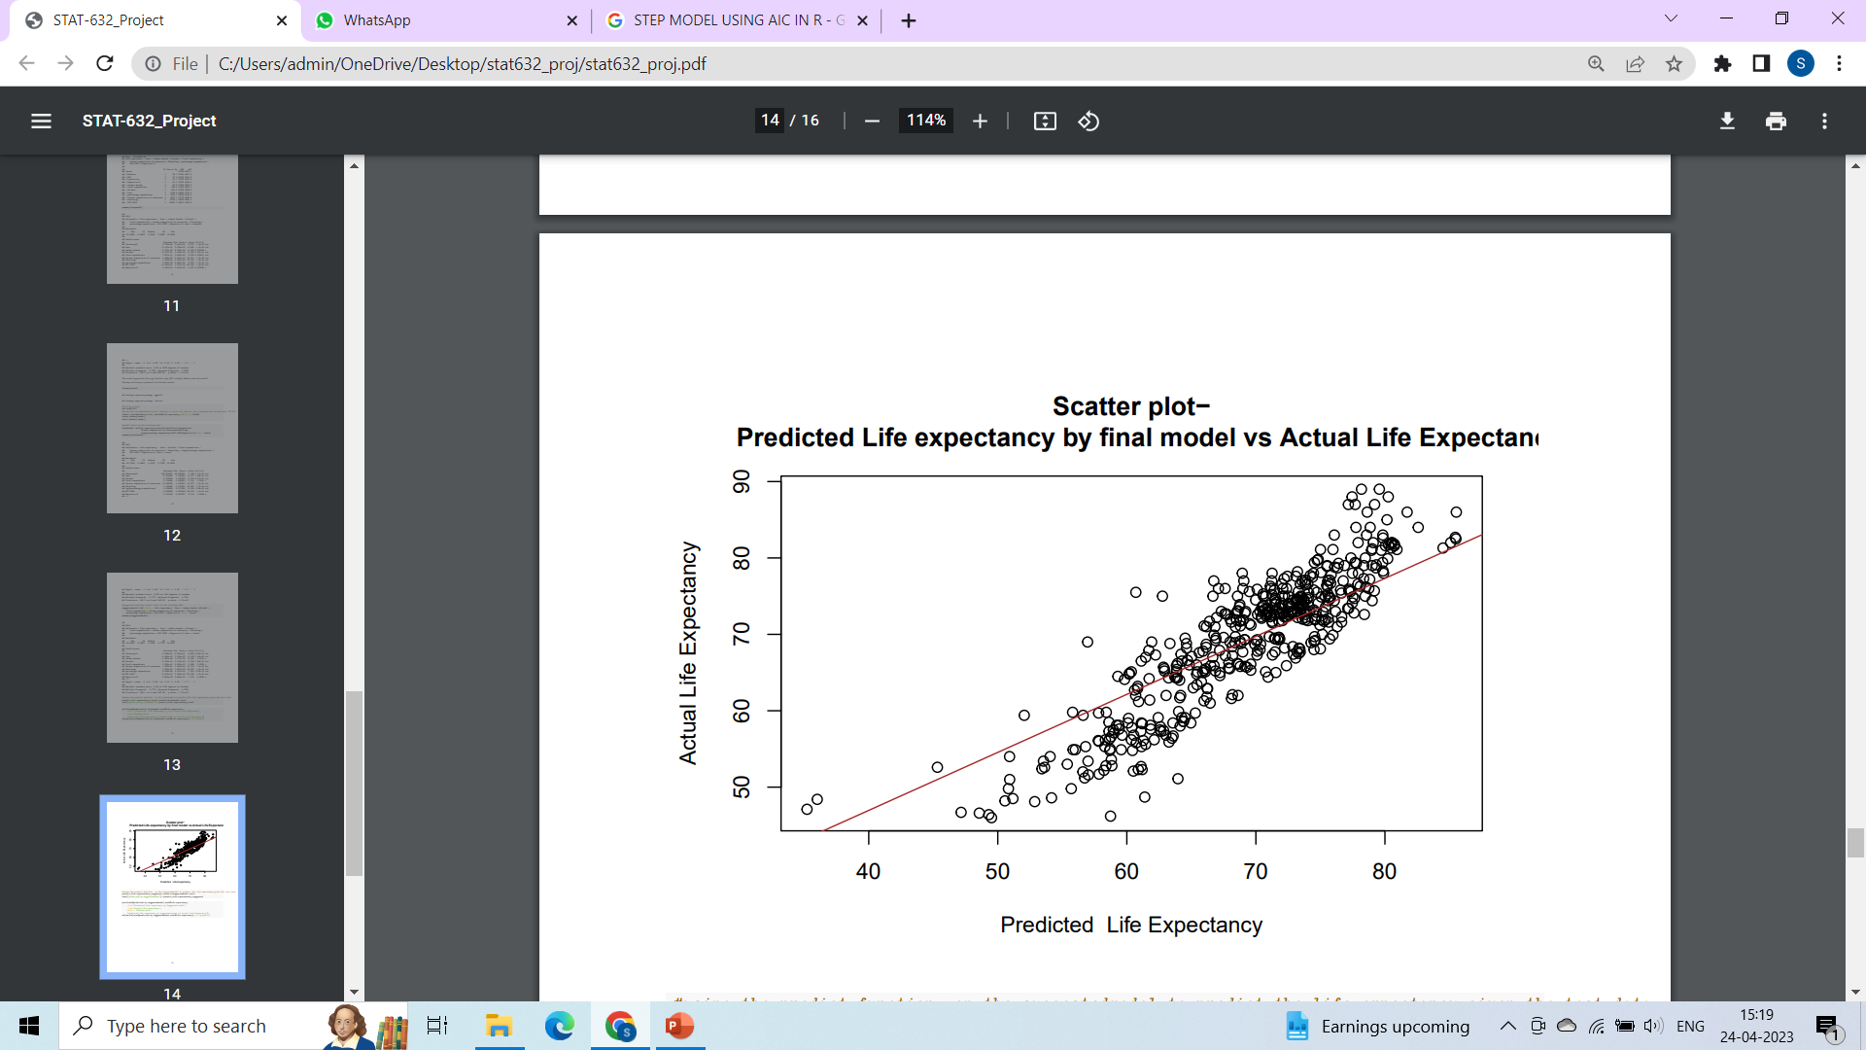
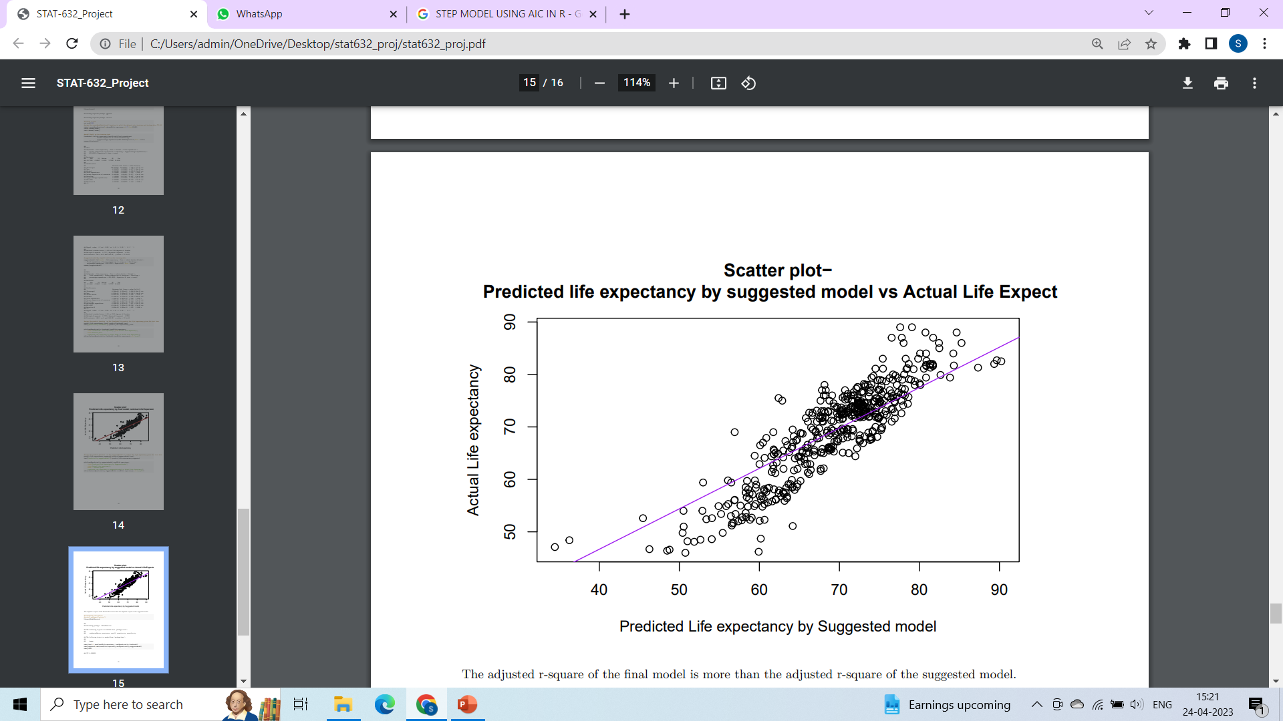
PREDICTED VALUE
VS
ACTUAL VALUE

Slide 23
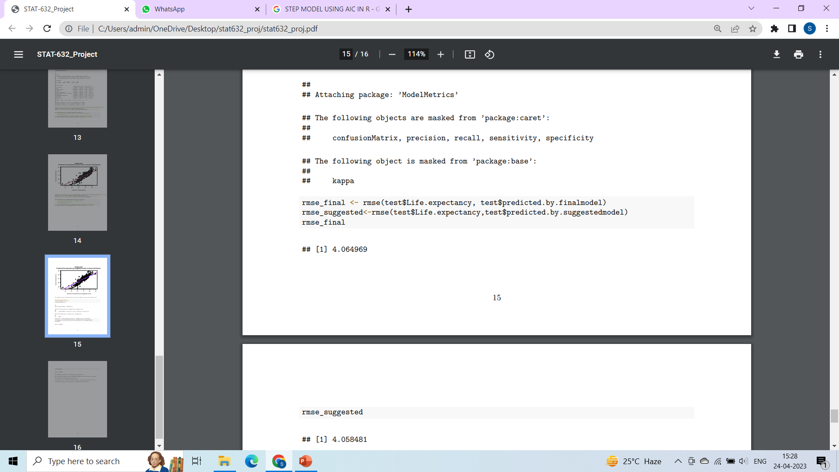
FINDING RMSE VALUE

Slide 24
SUMMARY OF BOTH THE MODELS
FACTOR | FINAL MODEL | SUGGESTED MODEL
p-value | 2.2e-16 | 2.2e-16
Adj R square | 0.7761 | 0.7755
RMSE | 4.0649 | 4.0584
Assumptions of MLR | Satisfied | Not satisfied

Slide 25
CONCLUSION
The final model has a slightly higher adjusted R-squared value (0.7761 compared to 0.7755 for suggested model), indicating that it explains slightly more of the variation in the response variable. Additionally, both models have the same very small p-value, indicating that the models are both statistically significant. The final model has a slightly higher RMSE value (4.0649 compared to 4.058 for suggested model), which means that its predictions are on average slightly less accurate, but the difference is very small. So, the final model is the best fit for predicting the life expectancy.

Slide 26
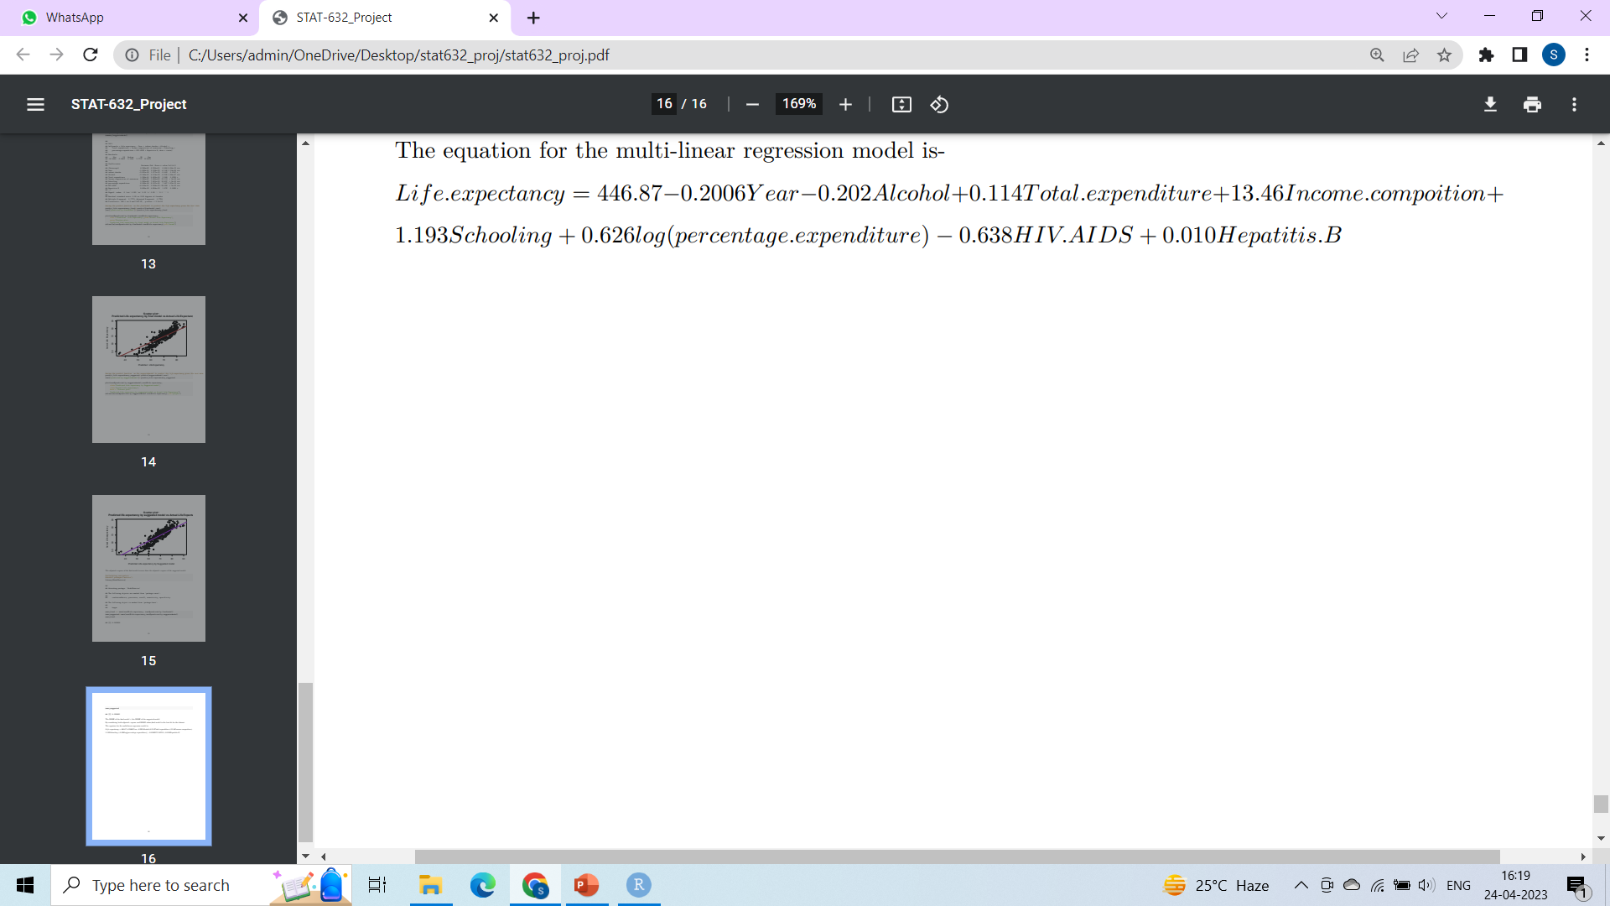
Equation of the best fit model

Slide 27
LIMITATIONS
Environmental factors: Environmental factors such as air pollution, water quality, and exposure to toxins can also have a significant impact on health and life expectancy.
Socioeconomic status: Socioeconomic factors such as income and occupation are known to be strong predictors of health and mortality. However, the WHO dataset does not include measures of these factors.

Slide 28

THANK YOU

